Slide 1


W3D1 – DataViz Lecture
LHL DS Bootcamp July 2020 Arunabh Singh

Slide 2
Why Data Visualization?
A picture is worth a thousand words.
A high level representation of data.
Be able to spot mistakes easy to overlook
Understanding the market audience ( Marketing, Politics, and Sales).
Predicting trend ( Time Series)

Slide 3
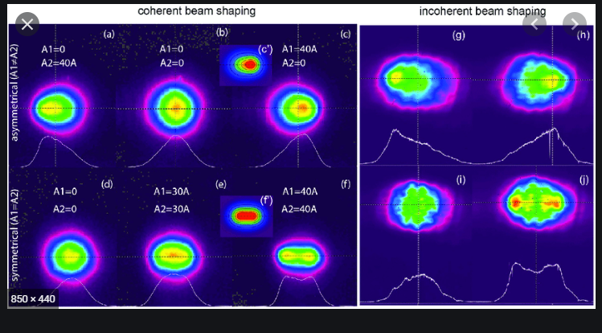
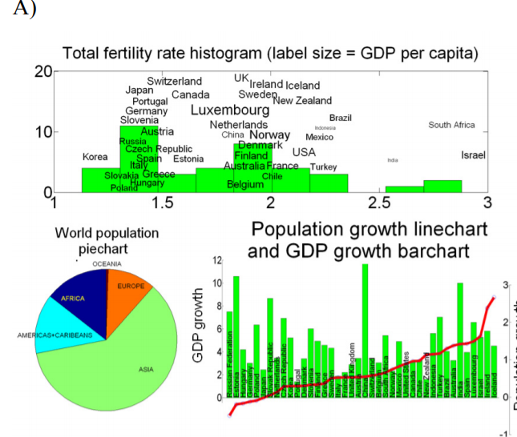
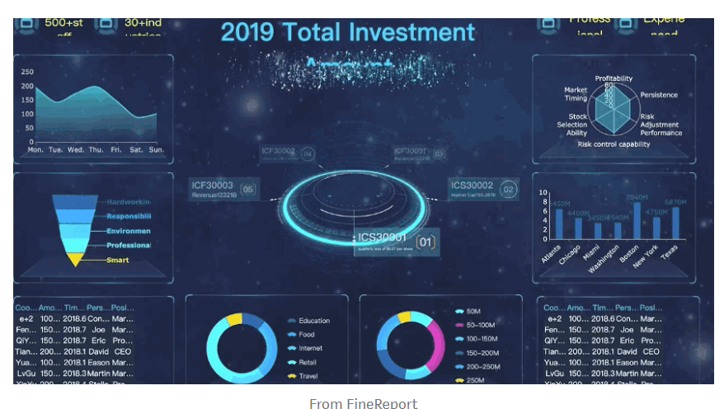
Design Principles
Symmetrical
Asymmetrical
Radial

Slide 4
More Design Principles
Emphasize – draw attention using colors, size, certain locations like top-left corner.
Movement – Follow an ‘F ‘ pattern of reading for user and place topics in that fashion.
Movement – Follow an ‘F ‘ pattern of reading for user and place topics in that fashion.
Pattern - establish a “pattern” by using similar objects, colors, and chart types to display the information. Disrupting the pattern naturally draws curiosity.
Repetition, Proportion and Rhythm

Slide 5
Tufte’s Integrity Principles
Representations of numbers should match their true proportions.
Labeling should be clear and detailed.
Designs should not vary from some ulterior motive, but show only data variations.
Well known units are best when representing money.
The number of dimensions represented should be the same as the number of dimensions in the data.
Representations should not imply an unintended context.

Slide 6
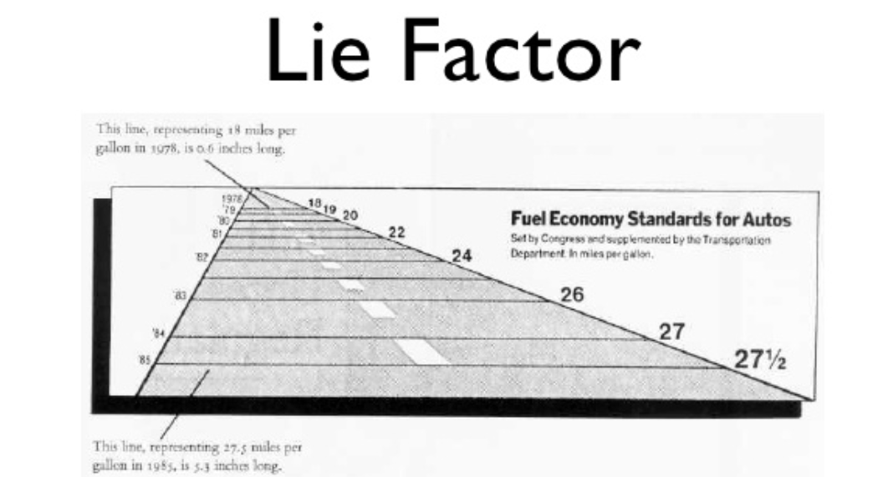
Lie Factor
Lie Factor = Size of Effect in graph/Size of effect in Data.
Lie Factor > 1 means graph overstates the effect.

Slide 7
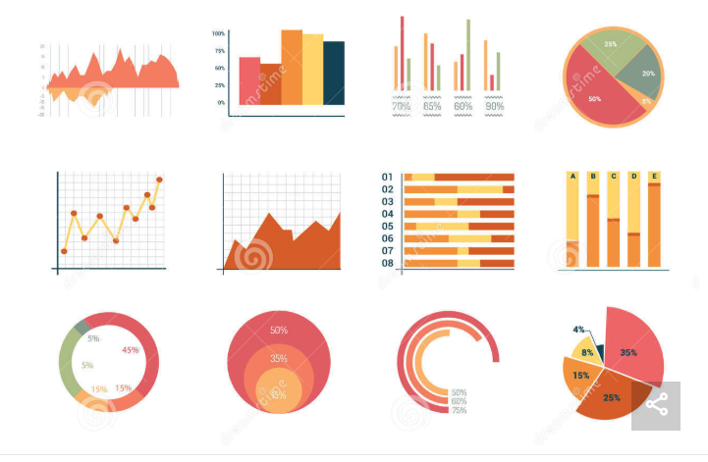
Basic Type of Charts

Slide 8
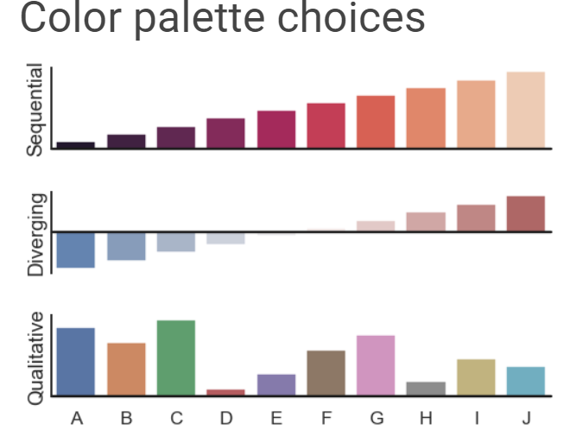
Bar Plot

Slide 9
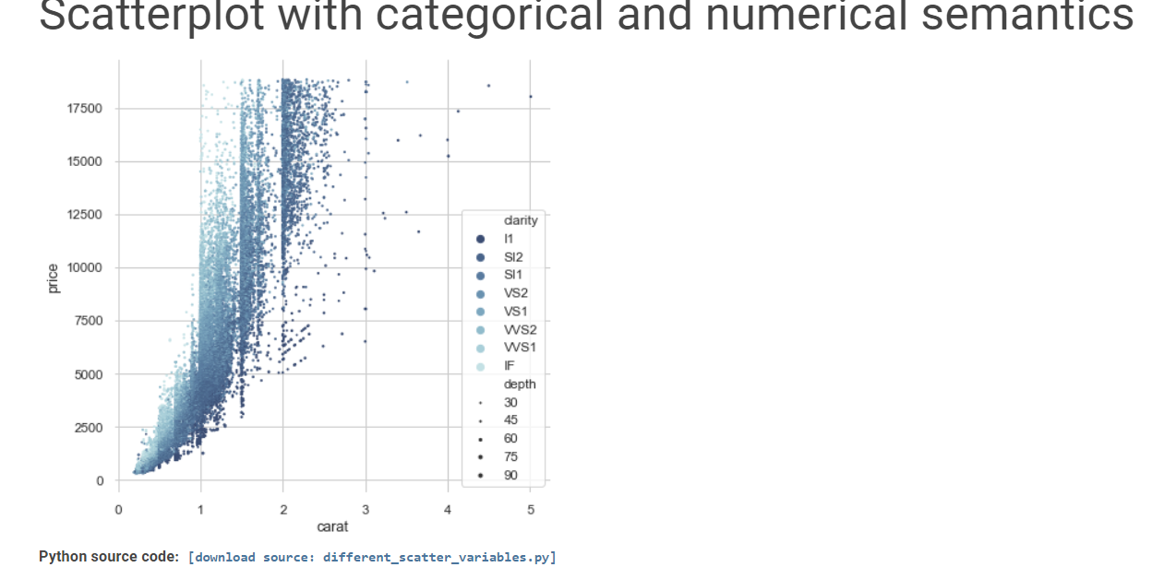
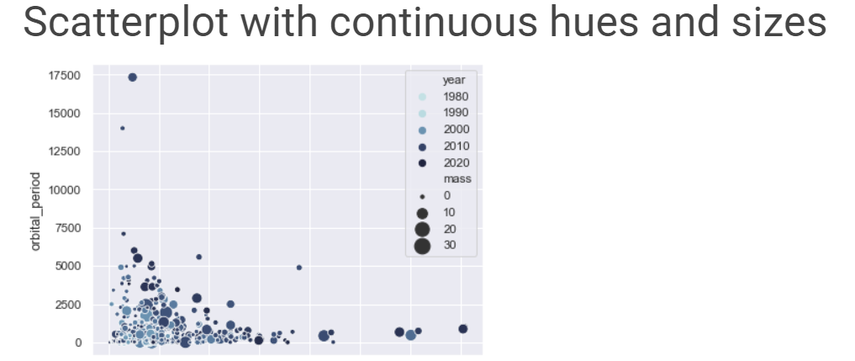
Scatterplot

Slide 10
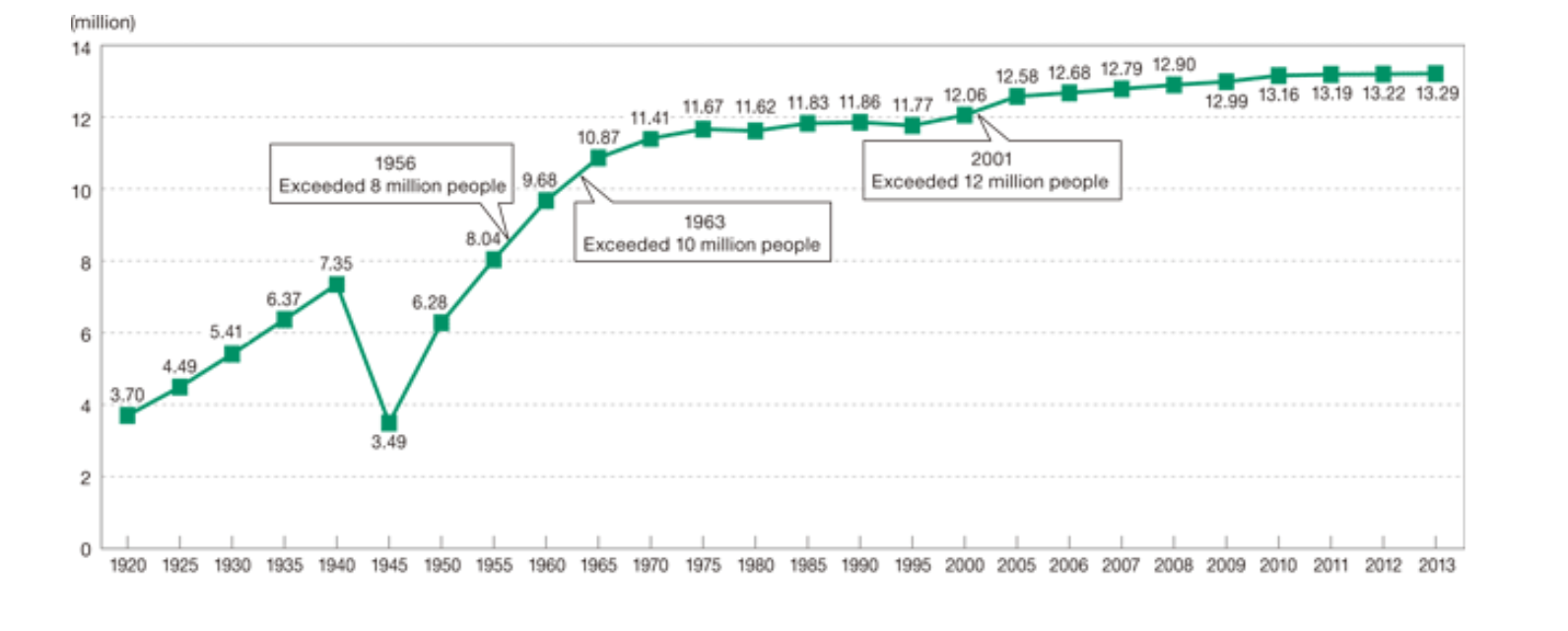
What’s wrong ?

Slide 11
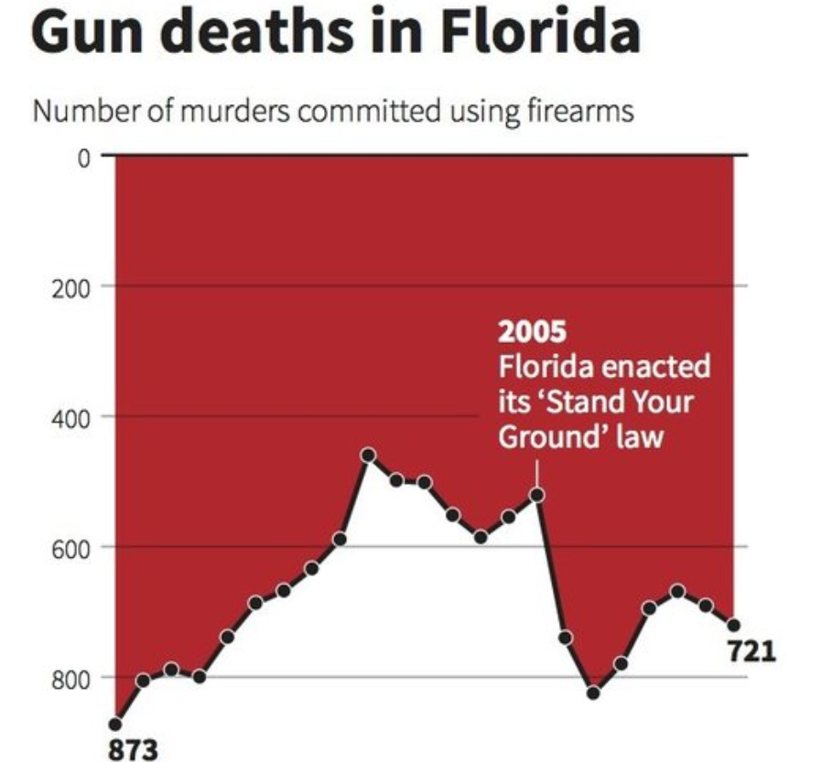
See anything incorrect?

Slide 12

Bad at Math!!

Slide 13
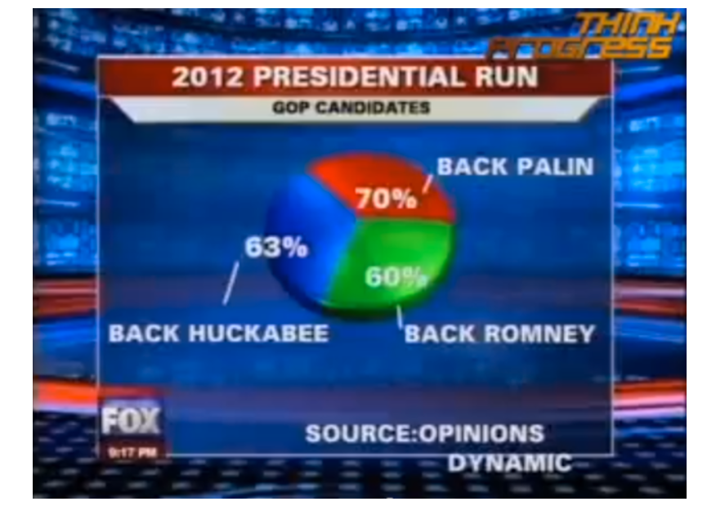
Media and Maths!!

Slide 14
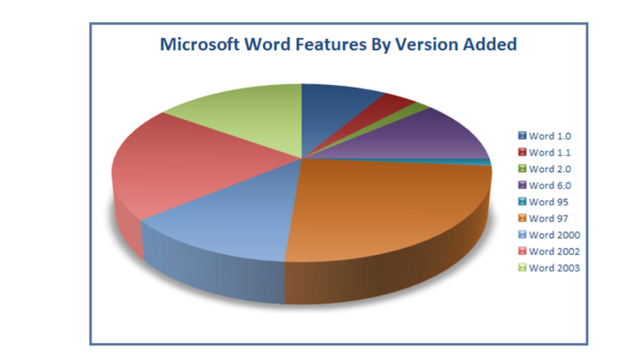
Nice Pie Chart eh!

Slide 15
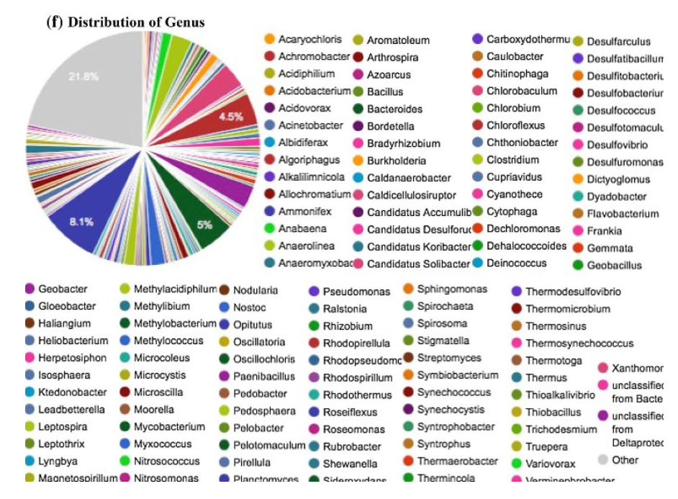
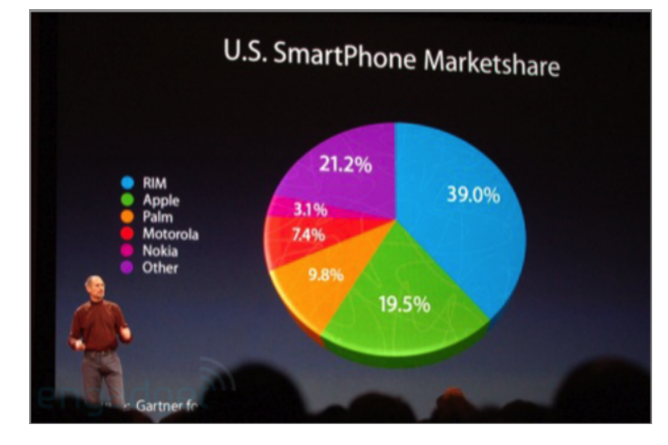
Pie Charts just get a bad rep

Slide 16
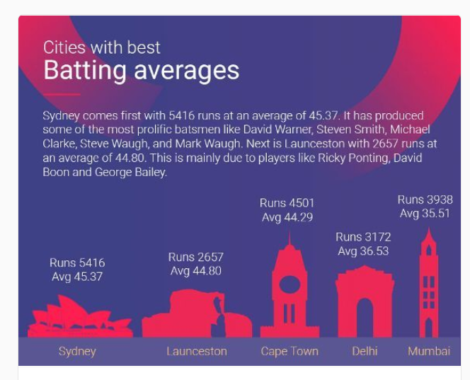
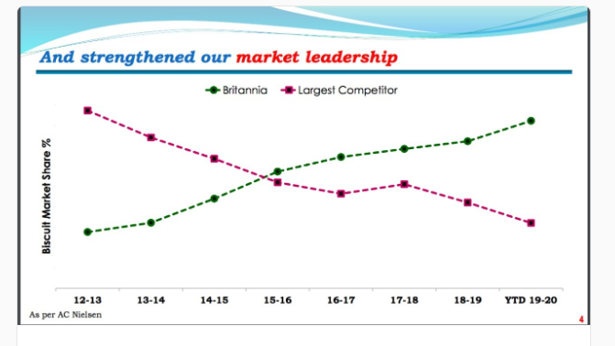
Some other Examples

Slide 17
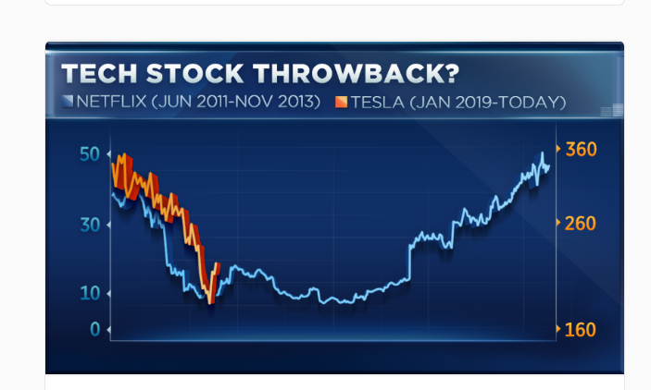
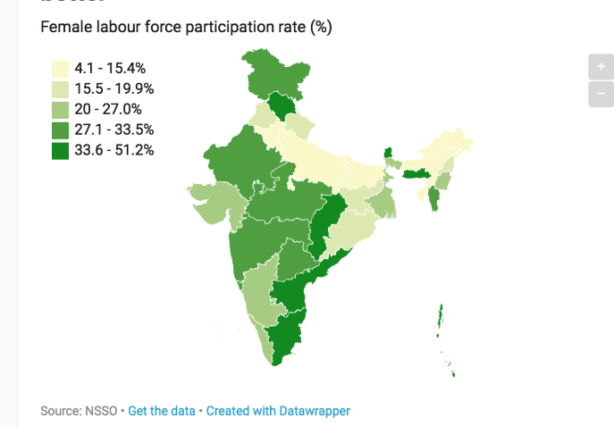
Less obvious ones

Slide 18
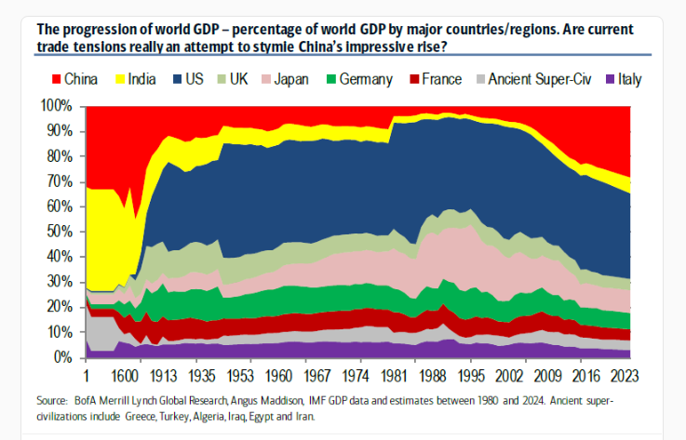
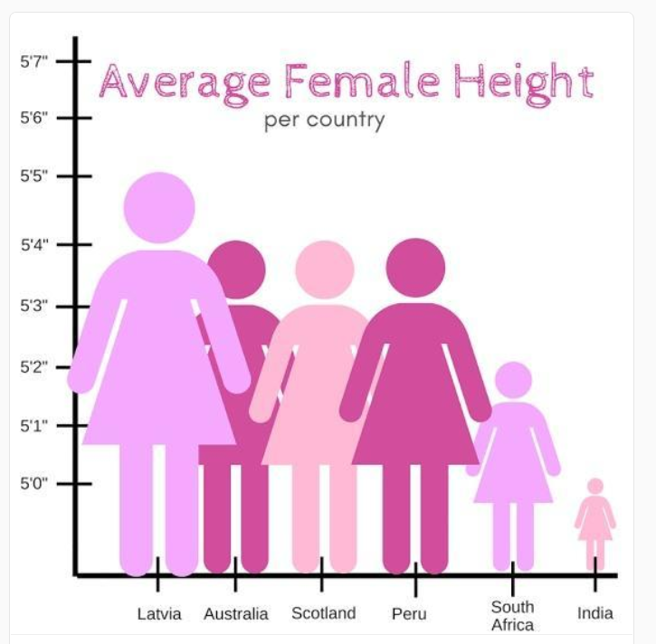
Scale always matters!! Period!

Slide 19
Scale always matters!! Period!

